Slide 1

Time Series Analysis of Corona Virus cases in African Countries (January 15th, 2020 - May 1st, 2020)
DSC 305 Final Project
Princess Allotey
princess.allotey@centre.edu

Slide 2
Problem and Motivation
Pandemic by World Health Organization(WHO) on 30th January 2020
By early May, the virus has spread to more than 200 countries worldwide
Focus on Africa because I am from Ghana, and I want to contribute to current research on COVID on the continent
There is a growing need to learn more about the virus including its mode of spread and its relation to indicators of interest

Slide 3




Data Discovery

Slide 4
Big Idea Questions (simplified)
What is the trend in COVID over the days under study?
2. What indicators can predict the likelihood of occurrence of COVID? (age, sex, government measures, school closures, travel history, travel to Wuhan, chronic disease)
*In short, modeling the rate of spread of the disease and its relation to indicators
*Still a Work in Progress

Slide 5
Time Series Data: 19 datasets
Indicators Data: 8 datasets
Cleaned data + extracted needed dataframes
*Did not get data for all African countries

Slide 6
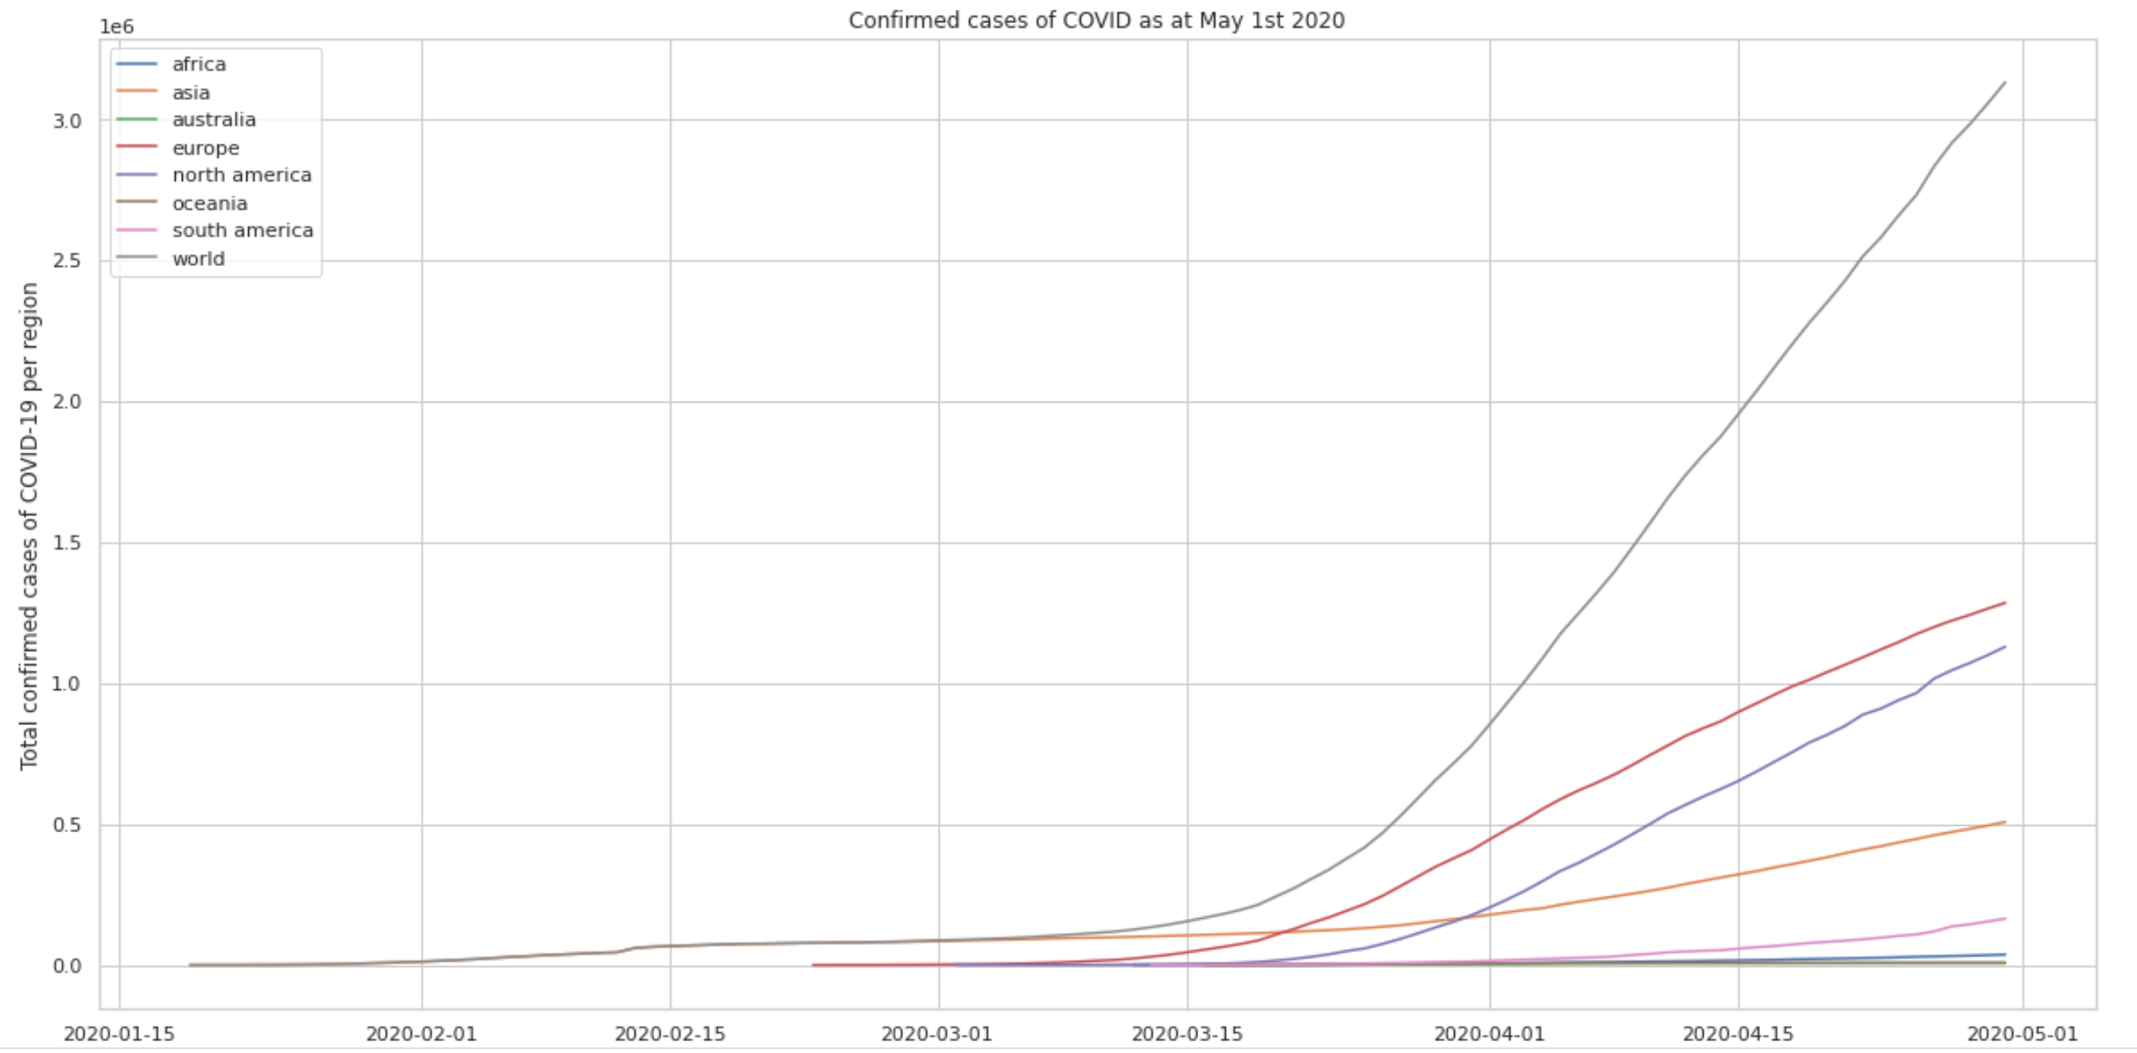
Data Exploration with Visuals

Slide 7
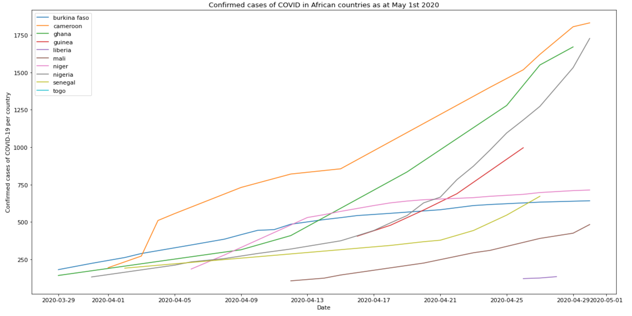

Slide 8
Models Used
NLTK with Ensemble method
RandomForestClassifier
LogisticRegressionCV
Logistic Model (formula)
*Will be presenting on only a sample of these

Slide 9
Using NLTK to predict whether a COVID patient will eventually die or survive the pandemic (outcome and additional_information columns)
Using NLTK model to predict whether a COVID patient will eventually die or survive the pandemic (chronic_disease_binary and outcome)
Using NLTK model to predict whether a COVID patient will eventually die or survive the pandemic (symptoms and outcome)
Using logistic models to predict when the COVID curve will flatten in selected African countries
Predicting the likelihood of death from COVID cases
Predicting the effect of current government measures on COVID cases (World)
Predicting the effect of current government measures on COVID cases (Africa)

Slide 10
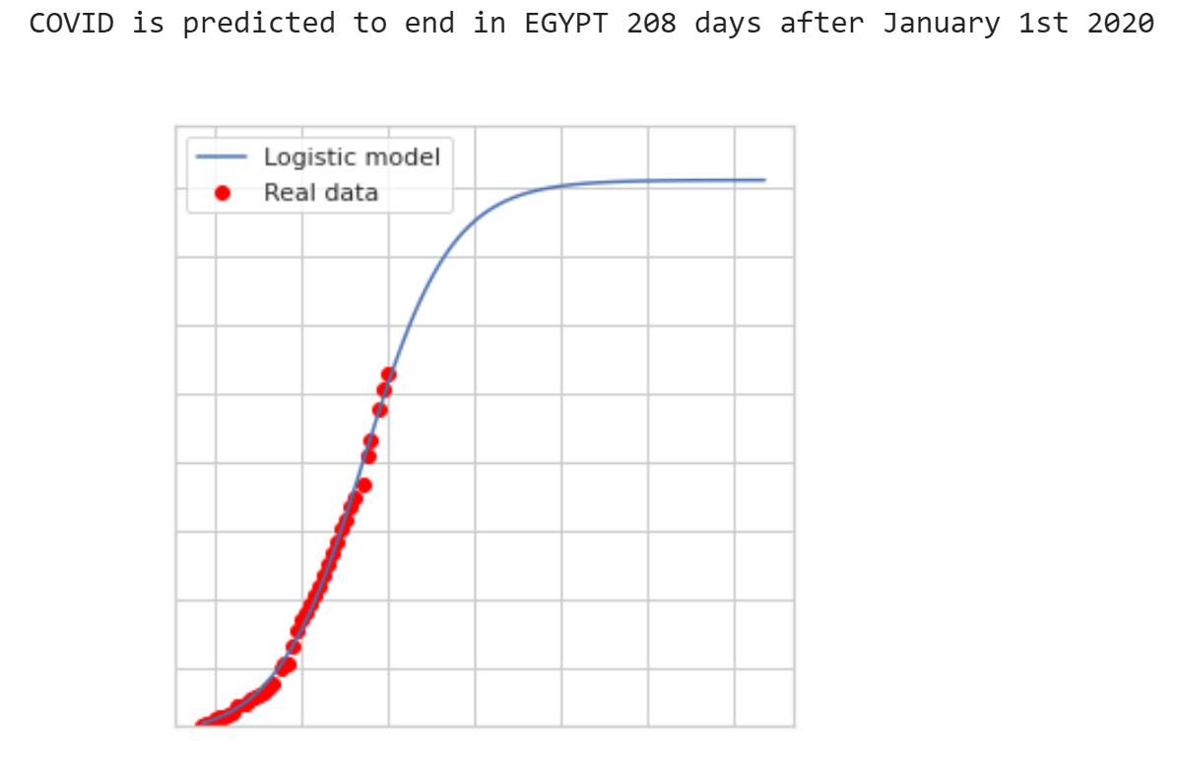
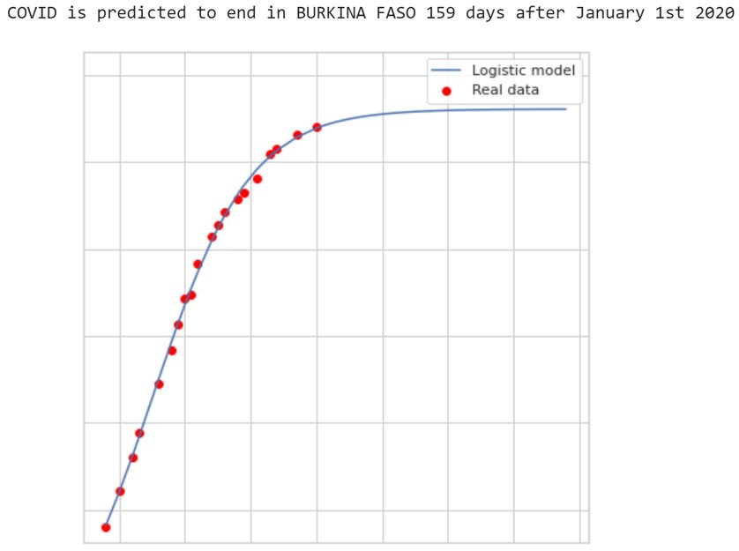

Slide 11
Core of NLTK function
remove punctuations
replace whitespace between terms with a single space
remove leading trailing whitespaces
change words to lower case - Hello, HELLO, hello are all the same word!
replace normal numbers with "numbr"
remove stop words from additional info
remove word stems using a Porter stemmer

Slide 12
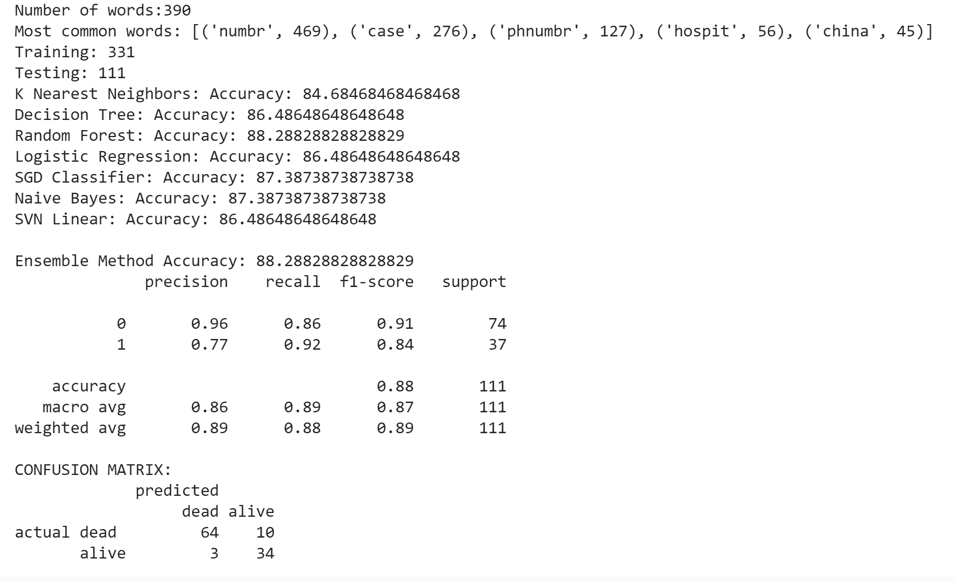
Using NLTK to predict whether a COVID patient will eventually die or survive the pandemic (WORLD) (outcome and additional_information columns) (260,000 rows of data on COVID patients)

Slide 13
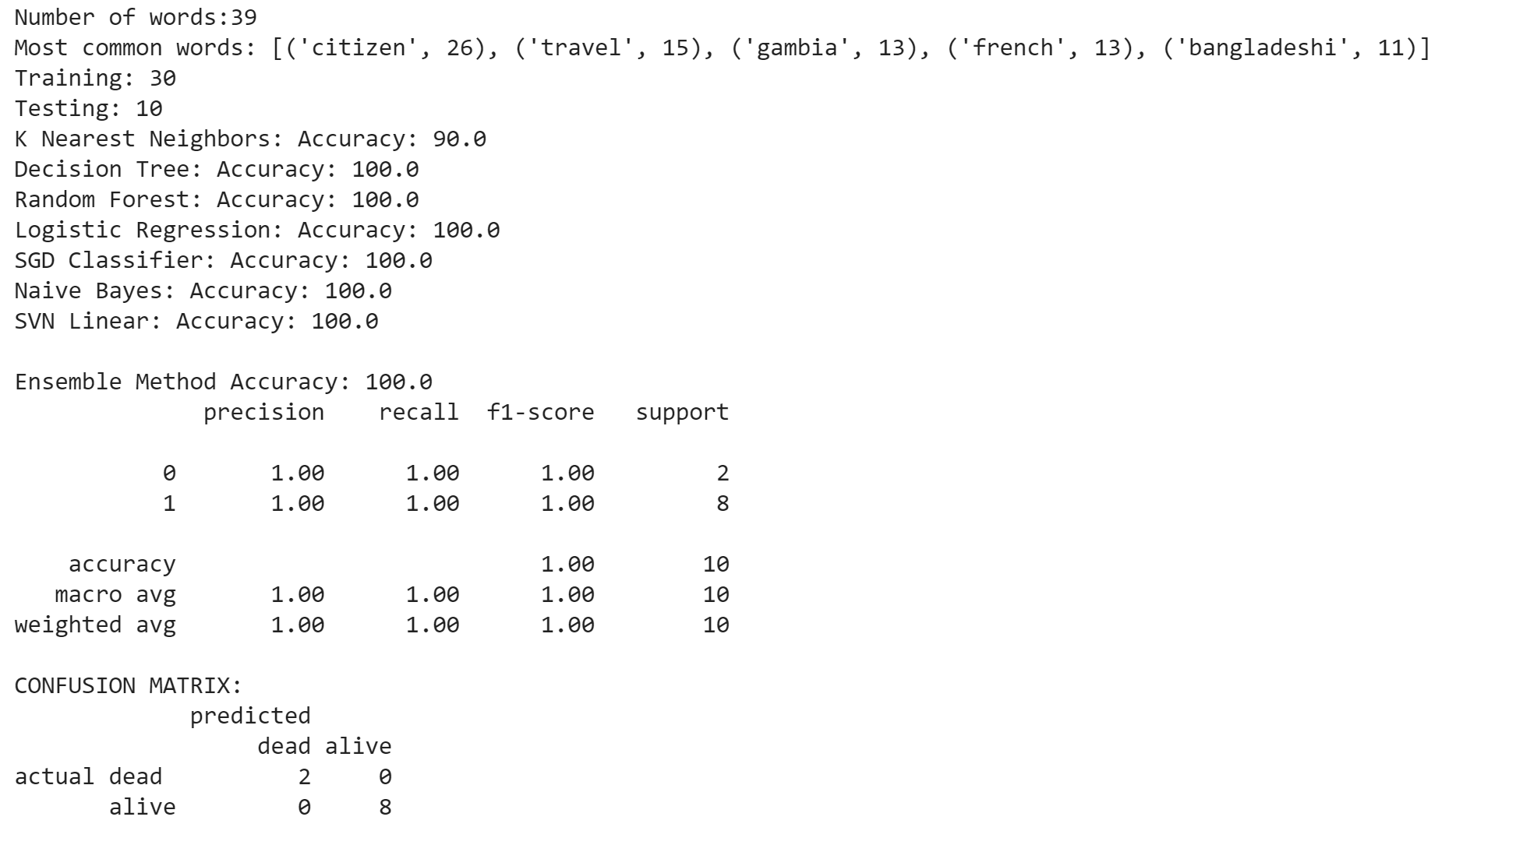
Using NLTK to predict whether a COVID patient will eventually die or survive the pandemic (AFRICA) (outcome and additional_information columns)
*Way more alive people than dead

Slide 14
Future Explorations (this summer!)
SIR Model (MAT 360 – Differential Equations)
Case studies
Consider more indicators:
ventilators available
number of tests
Body Mass Index
Immunological Naviety (for example, in North Korea)
population density affects the rate of spread of the virus
pollution

Slide 15

Operationalize Results
Governmental or non-governmental institutions in Ghana which might be interested in Data Science
Considering minoHealth AI Labs in Ghana: democratising Quality Healthcare with innovative and cutting-edge technologies like Artificial Intelligence, Data Science and Cloud computing in Africa.

Slide 16
References
Pydata, https://pandas.pydata.org/pandas-docs/version/0.13/visualization.html, Accessed 30th March 2020
Toward Data Science, https://towardsdatascience.com/covid-19-infection-in-italy-mathematical-models-and-predictions-7784b4d7dd8d/, Accessed 30th March 2020
Python Data Analysis Library, https://pandas.pydata.org/. Accessed 30th March 2020.
NumPy, https://numpy.org/. Accessed 30th March 2020.
skLearn, https://scikit-learn.org/stable/. Accessed 30th March 2020.
Seaborn, https://seaborn.pydata.org/. Accessed 30th March 2020.
Our World in Data, https://ourworldindata.org. Accessed 30th March 2020.
European Centre for Disease Prevention and Control,https://www.ecdc.europa.eu/en. Accessed 30th March 2020.
Centre for Systems Science and Engineering at Johns Hopkins University, https://github.com/CSSEGISandData. Accessed 30th March 2020.
World Health Organization (WHO), https://www.who.int/. Accessed 30th March 2020.
Be Outbreak Prepare, https://github.com/beoutbreakprepared/nCoV2019. Accessed 30th March 2020.

